Slide 2
" In The Name of Allah, The Most Beneficent, The Most Merciful" A glance on Traceability in Halal Products By: Dr. Hani M. Al-Mazeedi

Slide 3
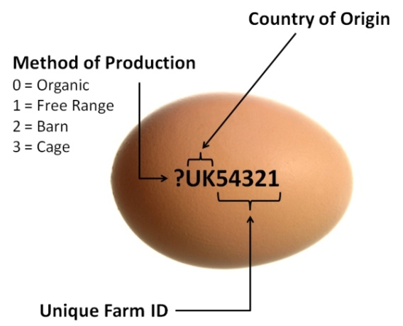
Scope
This presentation focuses on a system that has the ability to verify the history, location, or application of an item by means of documented recorded identification.
This system called Traceability.

Slide 4
Outline
Introduction
What does the term traceability refers to?
Why Traceability in Halal?
Scenarios in the Halal Traceability Process system
Conclusion
Recommendations

Slide 5
Introduction
A mere Halal logo alone is not sufficient to prove the Halalness of a product. A Halal Certification Procedure needs to be followed.
It is a religious obligation to make sure that our Halal products are genuinely Halal.

Slide 6
Manufacturers do not know how to evaluate, inspect and monitor the Halal being of Halal products and their production processes in their complete production chain.

Slide 7
Manufacturers do not know how to ensure the Halal being of Halal products to Muslim consumers or how to answer sensitive and in-depth questions concerning Halal issues.
Halal products may not smell, taste or look like Haram products.

Slide 8
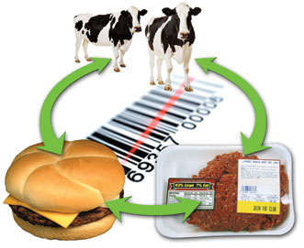
It is for this reason and others Traceability performed by a legitimate Halal certification body is necessary to insure the Halalness of products over their complete chain.

Slide 9
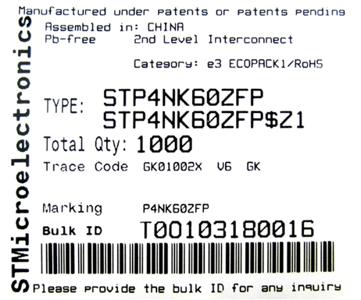
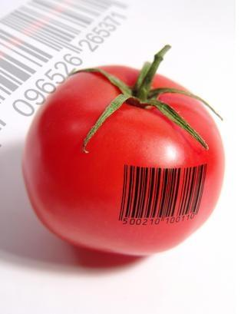
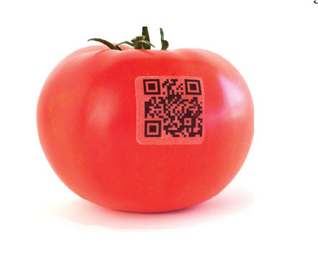
What does the term traceability refers to?
In Food Processing, Meat Processing, and Fresh Produce Processing
Traceability refers to the recording through means of tracking media, all movement of product and steps within the production process for the investigation of contamination or recalls.

Slide 10
Why Traceability in Halal?
To ensure that there is an efficient track and trace mechanism along the chain to check the Halal status of the food, non-food items and their sources.

Slide 11
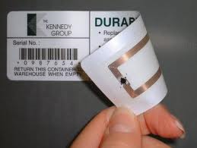
Efficient Halal traceability practices can be achieved using advanced technologies such as:
Radio-frequency identification (RFID), supply chain collaboration, computer-based documentation system and biological techniques are some examples of technologies currently used to enhance a traceability system.
Radio-frequency identification (RFID) is the wireless use of electromagnetic fields to transfer data, for the purposes of automatically identifying and tracking tags attached to objects. The tags contain electronically stored information.
Supply Chain Collaboration: Interaction supported by a technology between two or more parties that play a role in the supply chain in order to achieve a common goal and obtain mutual benefit.
The use of computer-based documentation tools confers many benefits to the delivery of evidence.

Slide 12
The efficiency of a Traceability of a Halal system depends on the implementation aspect which in turn relies on the execution by the key players*.
The key players in the Traceability Halal system are the stakeholders along the supply chain.
*Chen, R.-S., Chen, C.-C., Yeh, K. C., Chen, Y.-C., & Kuo, C.-W.(2008). Using RFID Technology in Food Produce Traceability. WSEAS Transactions on Information Science and Applications, 5 (11), 1551-1560.

Slide 13
In the Halal industry supply chain context, some of the stakeholders are also business organizations with their own goals, regardless of their positions (they might be suppliers, cultivators, logistics providers, etc.).
As a business entity, the main objective of a Halal firm is also the same as other businesses i.e. to maximize profit.

Slide 14
Halal firms at the same time have a very heavy responsibility towards the Muslim community or consumers, i.e. to inhibit them from consuming non-Halal products.

Slide 15
The government, on the other hand, as the leader of the country, is responsible for the citizens’ well-being.

Slide 16
In the process of implementing an efficient Halal traceability system along the supply chain, it is very important to investigate and identify stakeholder’s interests, needs, roles and responsibilities

Slide 17
We have three main scenarios in the Halal Traceability Process system:
Scenario 1:
Slaughtering Process
Scenario 2:
Certificate Authentication
Scenario 3:
Ingredient Verification

Slide 18
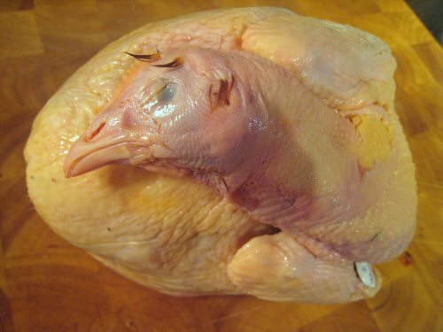
Scenario 1:
Slaughtering Process
Consumer found whole chicken bought from the retail store was not perfectly slaughtered.

Slide 19
She/he complaint to the store manager and also to the authority.

Slide 20
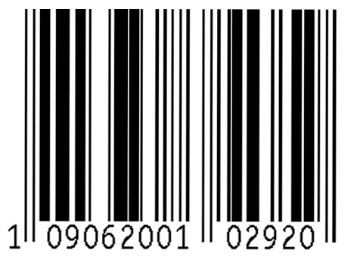
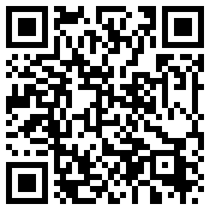
Store manager then use the ID on the label and search into their internal computer to know where the chicken came from.

Slide 21
Investigation of non-perfectly slaughtered chicken

Slide 22
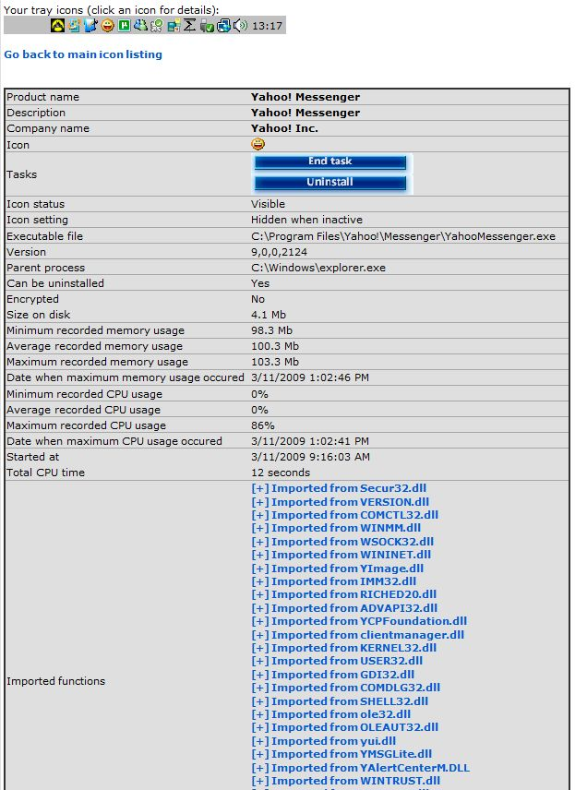
Agent’s internal computer
The Halal Traceability system will show the entire Halal chain and batches related to the product.

Slide 23
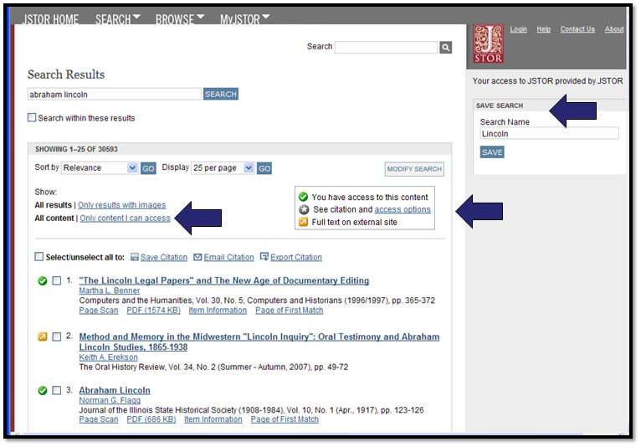
Results:
Whole chicken was received from: X (distributor).
The source of the chicken was imported from: Y slaughtering & processing plant.

Slide 24
Now, the Halal authorities
(local or abroad)
want to conduct further investigations!

Slide 25
Halal authorities’ internal computer
Results based on networking* with slaughtering & processing plant computer:
Records shows high number of Non Perfectly slaughtered birds that may have slipped into the market.
*Halal authorities should have access to slaughterhouse computers.

Slide 26
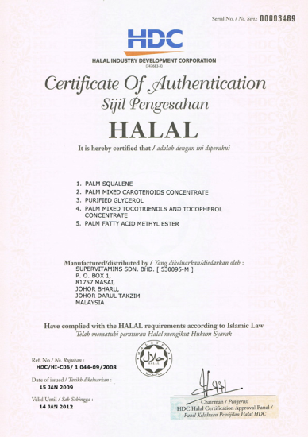
Scenario 2:
Certificate Authentication
A retail Quality Assurance, QA want to ensure the sausage sell at his display counter is Halal certified all the way over the processing line. He conducted some checks on received sausage prior to display

Slide 27
Quality Assurance Inspection of the Integrity of the Halal Chain
The QA picked up some sample with ID number and search in the Halal Traceability networking system.
Then he viewed the entire Halal chain of that particular sausage by clicking Global Trade Unit Graph (Global TU Graph).
Now he want to check all Halal certificates from both: Sausage Manufacturer and the Slaughter Plant.

Slide 28
Confirm with Supplier
First the QA check his immediate supplier, by using the Halal Traceability networking system, by clicking the outgoing shipment. The associate information will show up.
Then he click the certificate link associate with the outgoing shipment.

Slide 29
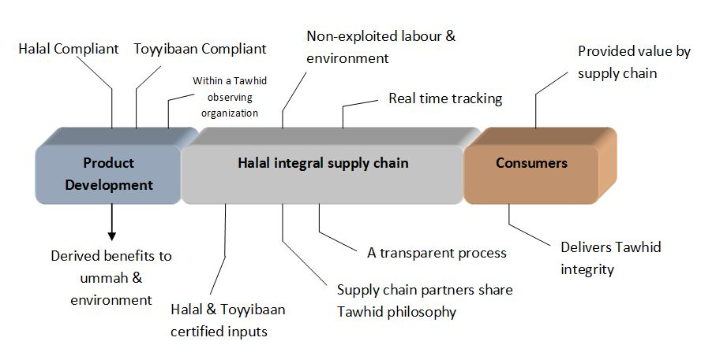
Scenario 3:
Ingredient Verification
Ensuring ingredient Halalness
The QA also want to ensure the ingredients used for making the sausage was Halal. He conduct some check to verify the ingredient Halalness.

Slide 30
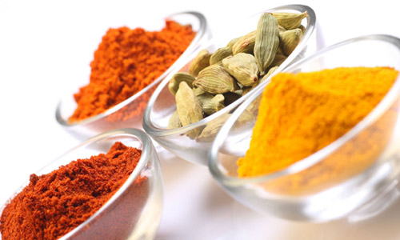
Zoom into supplier’s ingredient list
Using the same sample with same ID number of the sausage under investigation the QA can view the ingredients used to make the sausage.

Slide 31
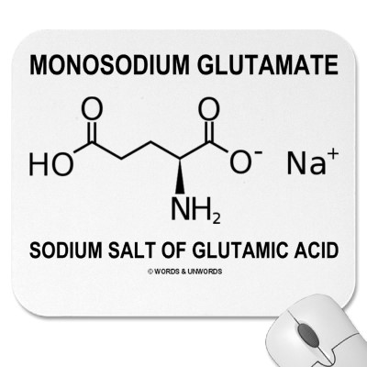
Inspect the properties
The properties of clicked ingredients ID will be popped-up.
Let say: Monosodium Glutamate (MSG).

Slide 32
Ingredient Verification
A third party web page (Halal Authority web page) will be popped-up for verification of that specific ingredient, i.e. Monosodium Glutamate (MSG).
Results:
E621
Monosodium Glutamate
Status: Halal

Slide 33
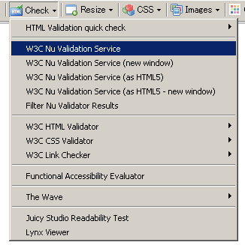
The QA will then do the same steps to check the Halal status of other ingredient (if available).

Slide 34
Conclusion
Stating that a meat or a processed product or a Halal service is Halal without a legitimate base such as Traceability or Halal analysis from an independent accredited Halal certifying body or from an independent accredited Halal test laboratory alone is not accepted.

Slide 35
Recommendations
Halal Traceability services must be encouraged among Halal Certification bodies.
Importing Muslim countries should request a Halal Traceability certificate on all Halal prodcucts.

Slide 36
References
Stakeholders’ Role for an Efficient Traceability System in Halal Industry Supply Chain: http://mmu-my.academia.edu/SitiZakiahMelatuSamsi/Papers/618002/Stakeholders_Role_for_an_Efficient_Traceability_System_in_Halal_Industry_Supply_Chain
Food Traceability : http://ec.europa.eu/food/food/foodlaw/traceability/factsheet_trace_2007_en.pdf
TraceTracker: http://www.tracetracker.com/

Slide 37
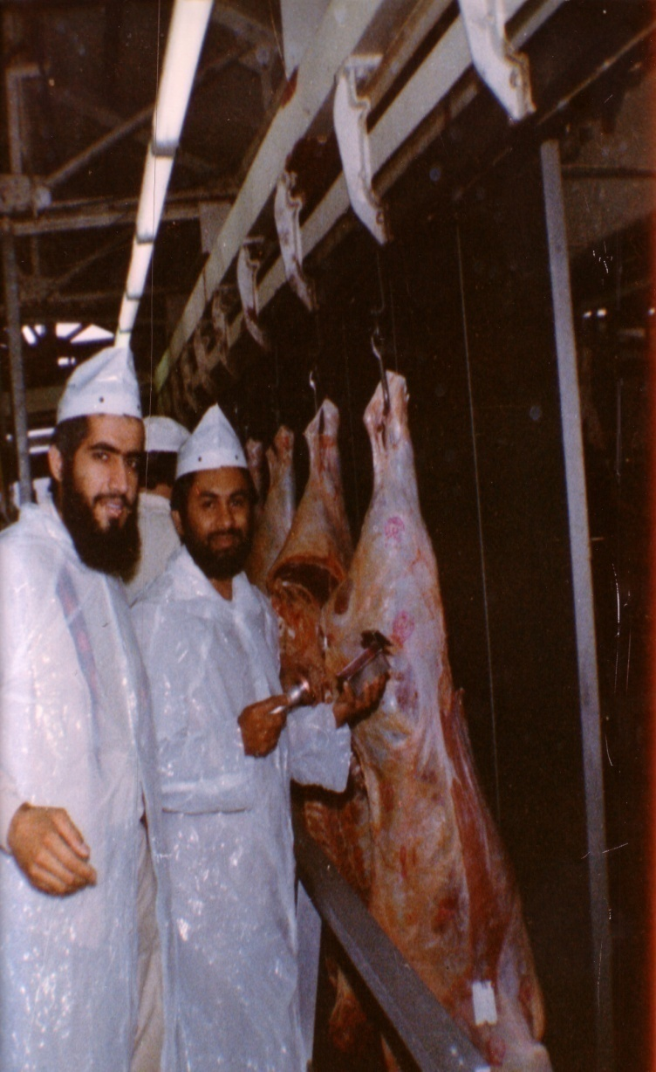
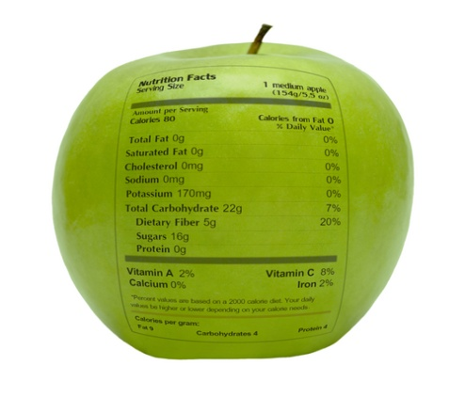
شكراً لاستماعكم
سبحنك اللهم وبحمدك أشهد أن لا إله إلا أنت، أستغفرك وأتوب إليك
د. هاني منصور المزيدي
مع الأخ أمجد محبوب في أستراليا سنة 1981
Dr. Hani Mansour Al-Mazeedi
With brother Amjad Mahboob in Australia in 1981

Slide 38
www.HalalEA.com
Trademarks, icons, images belong to their respective owners.
© Halal Sciences Academy Limited

